Slide 1
TEAM NEBULA
NETWORK AND INFORMATION SECURITY MANAGEMENT
SEMINAR 5: DATA BREACH CASE STUDY
07/07/21

Slide 2
Breach Checklist – Part 1
Case Study: Adult Friend Finder breach, 2016
What types of data were affected?
Email addresses, passwords, spoken languages and usernames.
Historic data up to 20 years old was included, including deleted accounts.
What happened?
412 million accounts were impacted by the breach which was caused by an unpatched vulnerability which had recently been revealed (Local File Inclusion vulnerability).
Who was responsible?
The responsible party has not been publicly identified but the breach was discovered by a security researcher by the name of ‘Revolver’.
Were any escalation(s) stopped - how?
Six databases containing the majority of account data were compromised so it is likely that lateral movement and escalation had already been achieved.
Notes:
https://haveibeenpwned.com/PwnedWebsites
https://www.csoonline.com/article/3139311/412-million-friendfinder-accounts-exposed-by-hackers.html
https://www.washingtonpost.com/news/the-switch/wp/2016/11/14/adult-friendfinder-hit-with-one-of-the-biggest-data-breaches-ever-report-says/

Slide 3
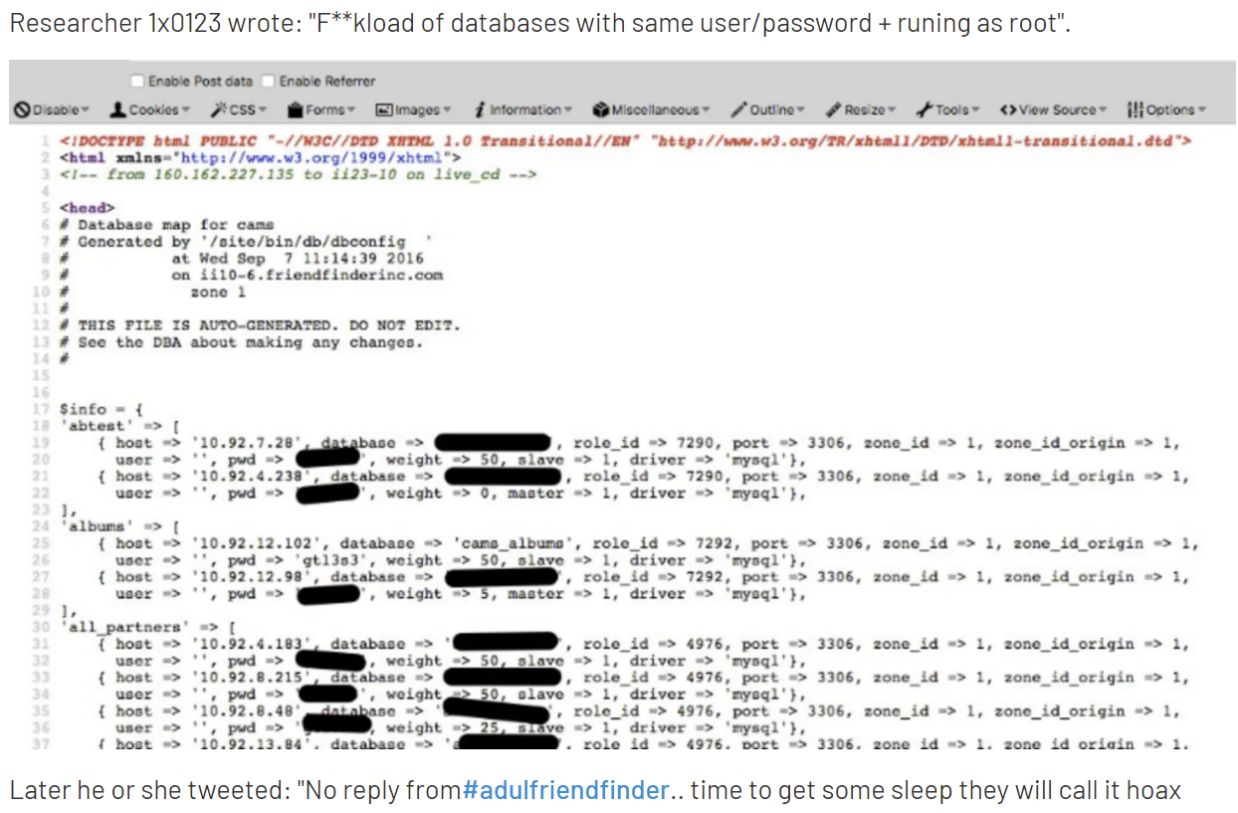

Slide 4
Breach Checklist – Part 2
Case Study: Adult Friend Finder breach, 2016
Was the Business Continuity Plan instigated?
This has not been publicly shared.
Was the ICO notified?
As this was pre-GDPR, the ICO would not have been informed of the breach as this was not a requirement.
Were affected individuals notified?
AFF released a statement saying they were communicating with impacted account holders.
What were the social, legal and ethical implications of the decisions made?
Sensitive data, including sexual orientation, with a potential for grave consequences on the data subject were released. Whilst there is no comment on the direct impact this breach had on data subjects, the Ashley Madison breach a year earlier revealed similar sensitive data and led to “resignations, divorces and suicides” (The Guardian, 2016).
Notes:
https://www.computerworld.com/article/3141290/biggest-hack-of-2016-412-million-friendfinder-network-accounts-exposed.html
https://www.idstrong.com/sentinel/adult-friend-finder-breach/
https://www.theguardian.com/technology/2016/feb/28/what-happened-after-ashley-madison-was-hacked
https://www.csoonline.com/article/2130877/the-biggest-data-breaches-of-the-21st-century.html

Slide 5
Recommendations
Encrypt data at rest using suitably strong algorithms (keys should be hardware secure)
Hash and salt passwords to store them securely
Implement suitable patching policy to ensure patches are rolled out without any delay
Get IDS & IPS
Improve firewall (firewall with proxy, that can drop SQLi even in encrypted packets)
Conduct regular penetration tests as well as employing suitable security testing, e.g. SAST & DAST, as part of the software development lifecycle (SDLC)
Segregate network to prevent lateral movement and consider a zero trust approach to protect sensitive personal data

